Slide 1
Discovering Spotify’s API features for Moosic
Notes:
We have been tasked by the aspiring music start-up Moosic with automatically creating playlists. But some concerns remained such that we are left with 3 main questions:

Slide 2
Research Questions
Are Spotify’s audio features able to identify “similar songs”, as defined by humanly detectable criteria?
Is K-Means a good method to create playlists?
Is it worth exploring other methods than K-Means to create playlists?

Slide 3
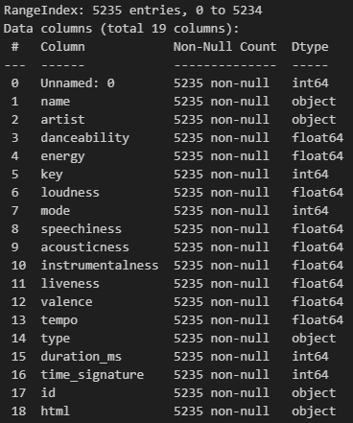
Overview and dropped columns
Unnamed:0 | duplicated index column; redundant
type | mostly empty column; might skew analysis
time_signature | small value range; handling benefits from advanced knowledge of music theory, thereby rather suited for professionals
html | redundant for analysis of quantitative audio features and building playlist
clusters: 25
Scaler: MinMaxScaler
Notes:
…and now up to Hans who will elaborate on the most prominent audio features

Slide 4
Comparing humanly- and computer-detectable audio features
We have to distinguish between:
objective, measurable (definitive) features (key, mode, time signature)
Subjective, non-measurable features (groove, harmony)
3 most weighted features:
Valence: positivity measurement, connects to key and mode but also depends on harmonies
low: slow blues, sad ballads, metal | high: Indie rock, modern pop - Detection works well
Energy: intensity, volume, dynamic range, percepted loudness
Metal, Dubstep, EDM - Detection works well
Danceability: combines tempo, rhythm stability, regularity, probably time signature
Depends on too much individual taste and unmeasurable features (groove, harmony)

Slide 5
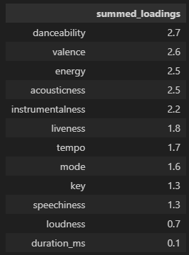
40% of all audio features (score > 2) contribute to 60% of the principal components
PCA on 5000 songs
Most prominent features
Experiment: Can we reproduce the same playlists with only top 4 audio features?

Slide 6
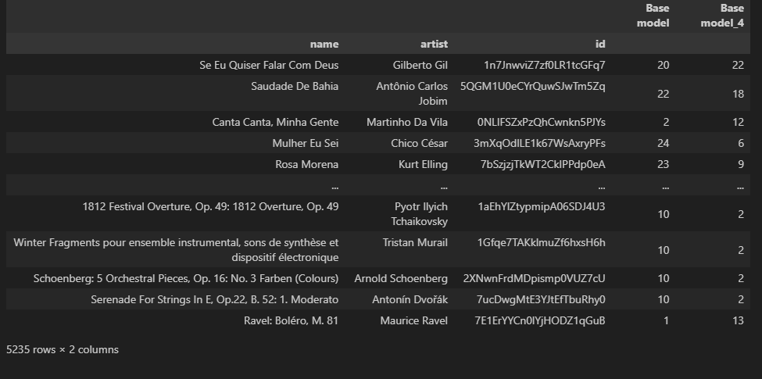
How low can we go?
Reducing the audio features from 12 to 4 results in only 6% similar song clustering.
Consequently, all audio features should be taken into account to create playlists close to human perception.

Slide 7
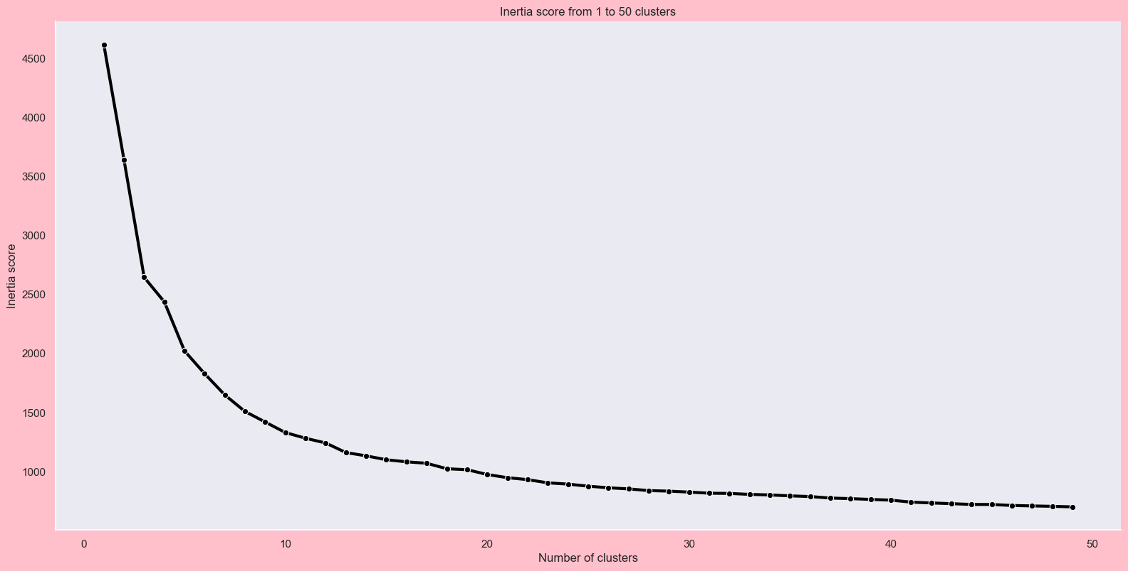
Elbow method to choose number of Clusters

Slide 8
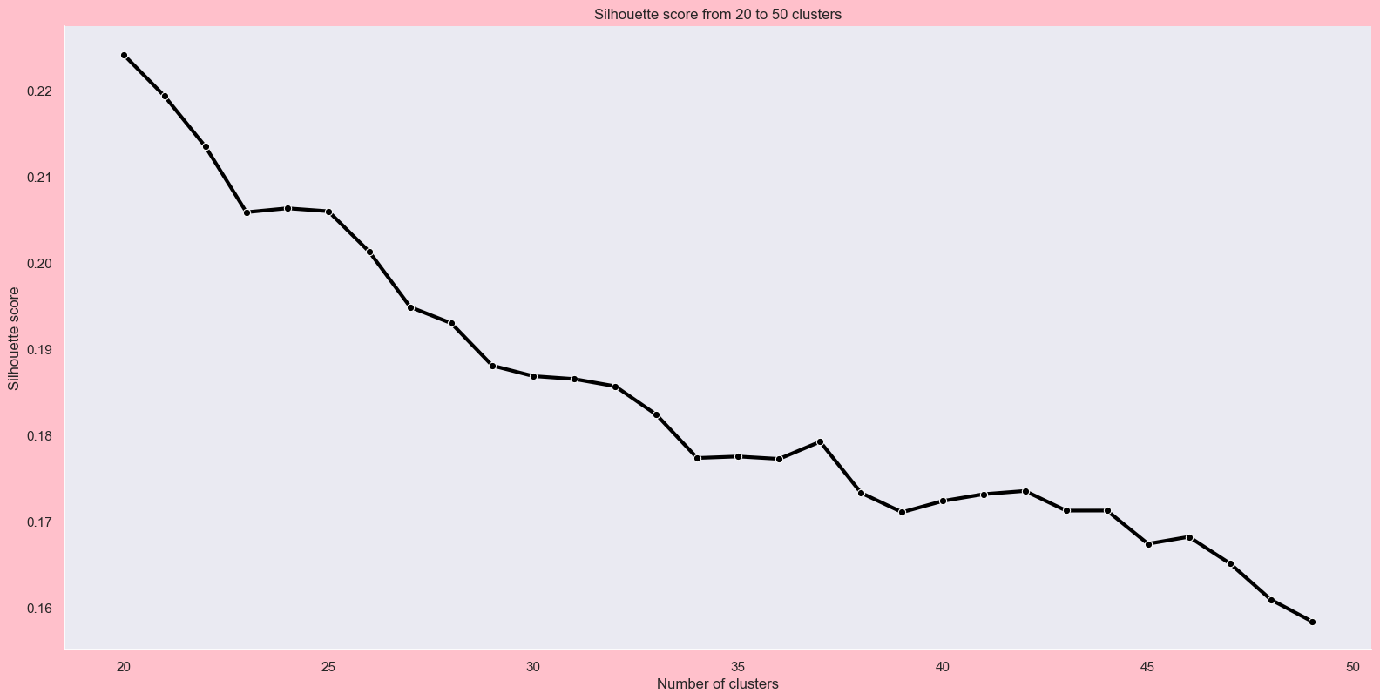
Silhouette Score shows a probable k= 25

Slide 9
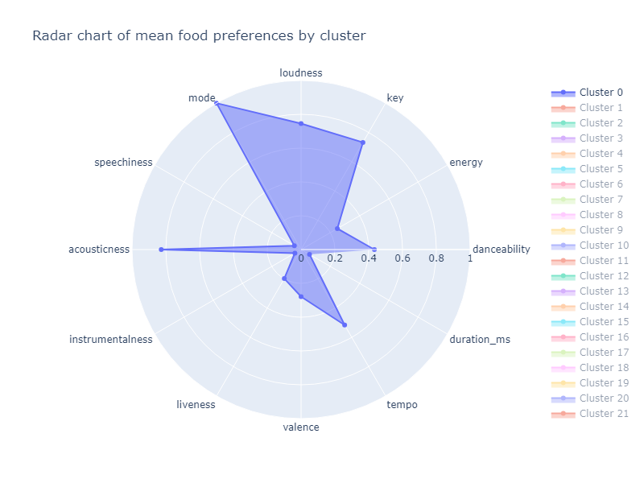
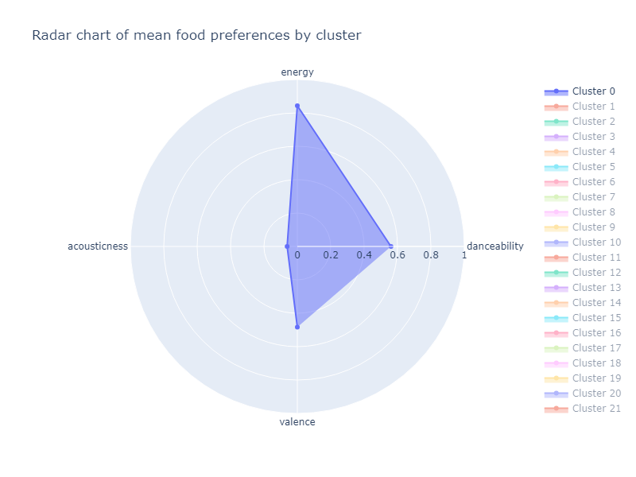
Radar chart of mean 12 features by cluster (0)
Radar chart of mean 4 features by cluster (0)

Slide 10
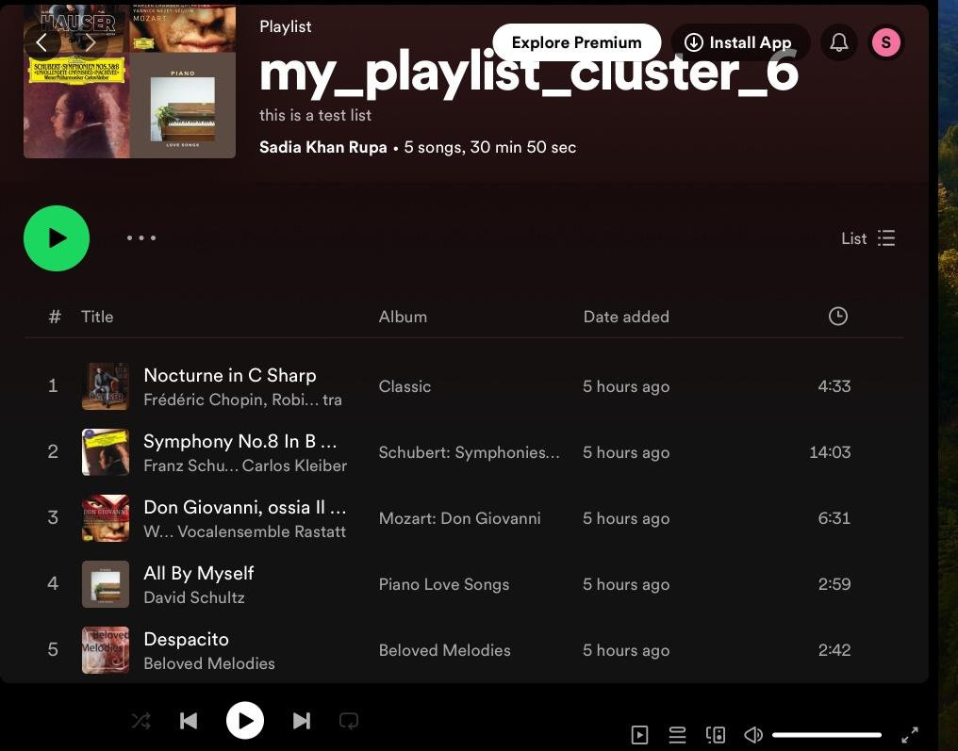
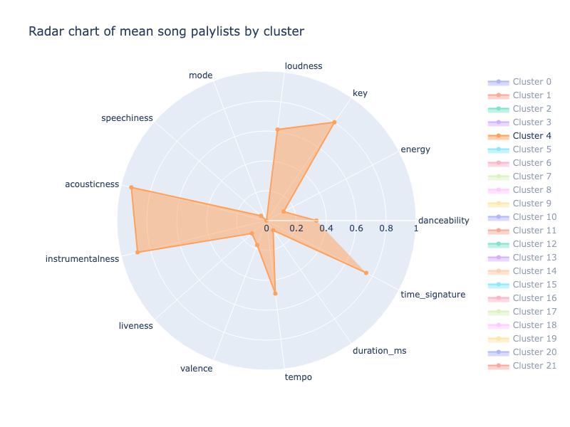
Playlist for Acoustic Songs
Despacito

Slide 11
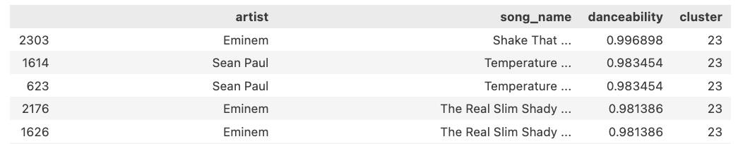
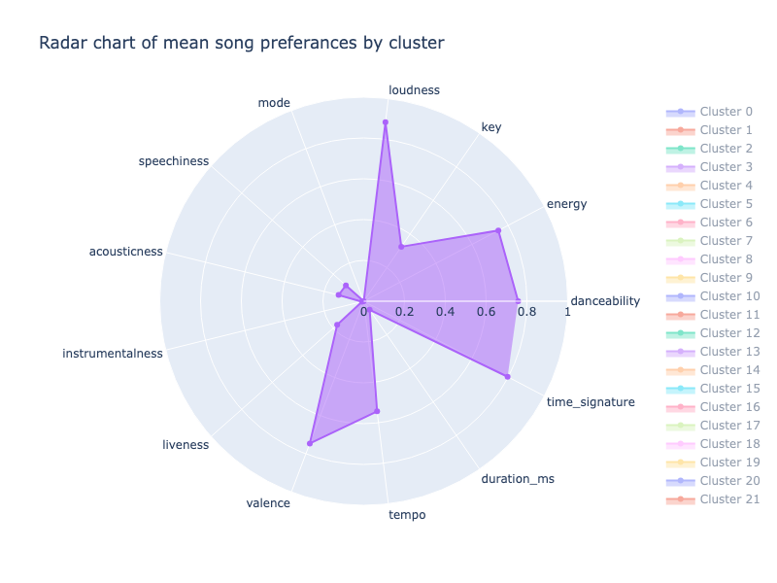
Cluster for Danceable songs
The Real Slim Shady

Slide 12
Other Clustering Methods
Hierarchical Clustering -
for differently sized playlists
K Nearest Neighbor -
when working with labelled clusters

Slide 13
Thank you for listening

Slide 14
Research Questions
Are Spotify’s audio features able to identify “similar songs”, as defined by humanly detectable criteria?
Comparison of conventional audio features (e.g. time signature) with DS-engineered audio features
Is K-Means a good method to create playlists?
Comparison of conventional audio features (e.g. time signature) with DS-engineered audio features
Is it worth exploring other methods than K-Means to create playlists?
Limitations of K-Means modeling / Comparison of clustering using less audio features (Christian + Sonia)
We don’t have categorical data to train our models with (apart from html which doesn’t describe songs), we are OK with using only K-Means.

